Slide 1
EXPERIMENTAL PROBABILITY

Slide 2

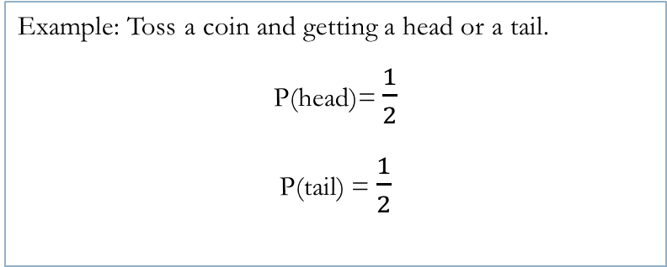
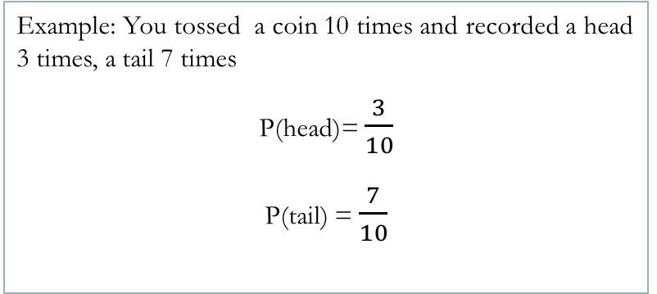
24
7
30
Topic: Two step Probability with replacement
Date:
EQ – What is experimental probability with replacement?
Experimental vs.
Theoretical
Probabilty can have two approaches:
Experimental Probability and Theoretical Probability
What actually happens vs. What we think will happen
P (event) = $\frac{number of times event occurs}{total number of trials}$ P (event) = $\frac{number of favorable outcomes}{number of possible outcomes}$
Example: You tossed a coin 10 times and recorded a head 3 times, a tail 7 times
P(head)= $\frac{3}{10}$
P(tail) = $\frac{7}{10}$
Example: Toss a coin and getting a head or a tail.
P(head)= $\frac{1}{2}$
P(tail) = $\frac{1}{2}$

Slide 3
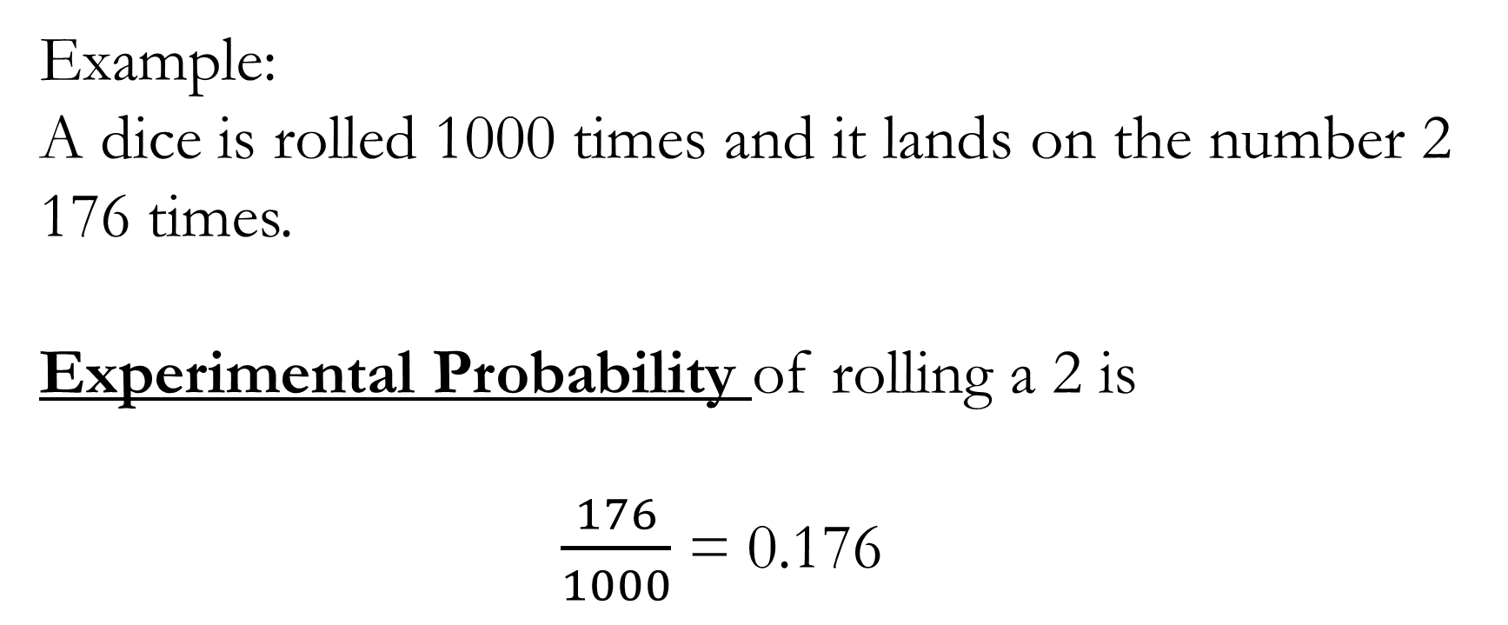
Example:
A dice is rolled 1000 times and it lands on the number 2 176 times.
Experimental Probability of rolling a 2 is
$\frac{176}{1000}$ = 0.176

Slide 4
Essentials book page 126
DESIGN a SPINNER
Hold a paper clip 20cm above the centre of the rectangle.
Drop the paperclip and record where it lands (inside rectangle, on the edge, outside the rectangle)
Repeat 50 times
Use the percentages in your table to represent the probabilities as a fraction of each.
 | In rectangle | On the edge | Outside rectangle | TOTAL
Tally |  |  |  | 50
Frequency |  |  |  | 50
Percentage |  |  |  | 100%

Slide 5
Essentials book page 127
COUNTERS
Two red and one blue counters are placed in a bag.
Without looking, two counters are taken out together.
Is it more likely that the two counters are both red or that one is red and one is blue?
Complete a) b)
Same colour | Different colours

Slide 6
The law of LARGE NUMBERS
The more experiments/trials we do, the closer the results will be to the TRUE probability.
Complete Part c) as a class
Same colour | Different colours

Slide 7
Text book – page 128 – 129
Complete questions 3 and 4

